Slide 1
資料可視化
許瑋哲

Slide 2
Ambient Information Visualisation and Visitors’ Technology Acceptance of Mixed Reality in Museums

Slide 3
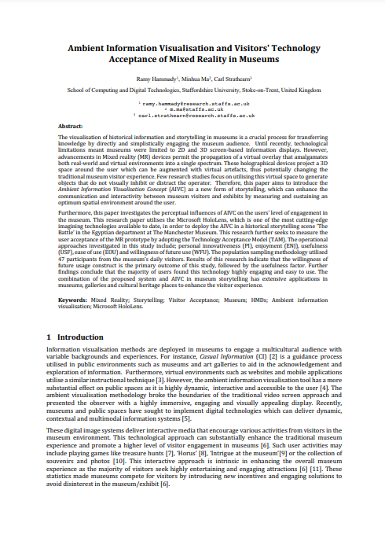

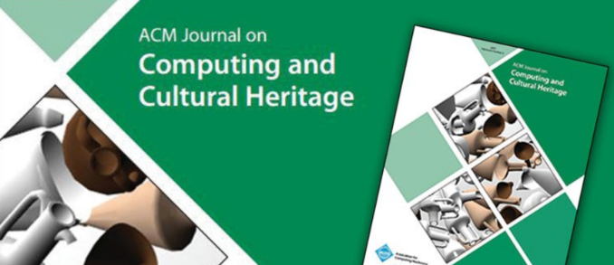

Slide 4
摘要

Slide 5
摘要
The visualisation of historical information and storytelling in museums is
a crucial process for transferring knowledge by directly and simplistically engaging the museum audience. Until recently, technological limitations meant museums were limited to 2D and 3D screen-based information displays.
在博物館中將歷史和故事情節可視化是將知識直接且簡單地傳達給觀眾的一個至關重要的過程。直到最近，技術限制使博物館僅限於2D和3D屏幕顯示資料。

Slide 6
摘要
However, advancements in Mixed reality (MR) devices permit the propagation of a virtual overlay that amalgamates both real-world and virtual environments into a single spectrum.
然而，混合現實（MR）設備的進步允許虛擬疊加的傳播，將現實世界和虛擬環境融合成一個單一的世界。

Slide 7
摘要
Few research studies focus on utilising this virtual space to generate objects that do not visually inhibit or distract the operator. Therefore, this paper aims to introduce the Ambient Information Visualisation Concept (AIVC) as a new form of storytelling, which can enhance the communication and interactivity between museum visitors and exhibits by measuring and sustaining an optimum spatial environment around the user.
很少有研究集中於利用這個虛擬空間來生成不會在視覺上阻礙或分散操作者注意力的物體。因此，本文介紹環境信息可視化概念（AIVC）作為一種新的故事講述形式，可以通過測量和維持使用者周圍的最佳空間環境來增強博物館參觀者和展品之間的交流和互動。

Slide 8
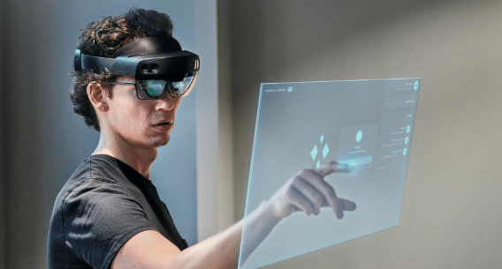
摘要
Furthermore, this paper investigates the perceptual influences of AIVC on the users' level of engagement in the museum. This research paper utilises the Microsoft HoloLens, which is one of the most cutting-edge imagining technologies available to date, in order to deploy the AIVC in a historical storytelling scene 'The Battle' in the Egyptian department at The Manchester Museum.
此外，本文研究了AIVC對博物館使用者參與度的感知影響。這篇研究論文利用了截至目前為止最尖端的MR設備之一——Microsoft HoloLens，以在曼徹斯特博物館的埃及部門部署AIVC在歷史敘事場景「戰鬥」中。

Slide 9
摘要
This research further seeks to measure the user acceptance of the MR prototype by adopting the Technology Acceptance Model (TAM). The operational approaches investigated in this study include; personal innovativeness (PI), enjoyment (ENJ), usefulness (USF), ease of use (EOU), and willingness of future use (WFU).
此研究進一步旨在通過採用技術接受模型（TAM）來衡量MR原型的使用者接受度。研究中探討的重點包括：個人創新性（PI）、享受度（ENJ）、實用性（USF）、易用性（EOU）和未來使用意願（WFU）。

Slide 10
摘要
Results of this research indicate that the willingness of future usage construct is the primary outcome of this study, followed by the usefulness factor. Further findings conclude that the majority of users found this technology highly engaging and easy to use.
研究結果顯示，未來使用意願構建是本研究的主要結果，其次是實用性因素。進一步的發現得出結論，大多數使用者認為這項技術非常吸引人且易於使用。

Slide 11
摘要
The combination of the proposed system and AIVC in museum storytelling has extensive applications in museums, galleries, and cultural heritage places to enhance the visitor experience.
所提出的系統與AIVC在博物館敘事中的結合在博物館、畫廊和文化遺產場所中具有廣泛的應用，可增強參觀者觀展體驗。

Slide 12
圖片

Slide 13
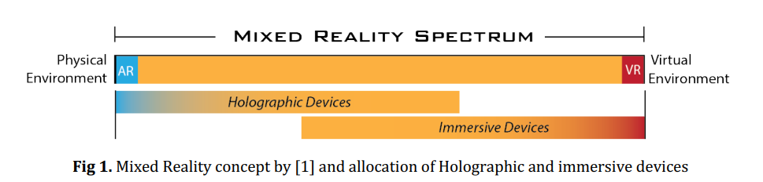

Slide 14
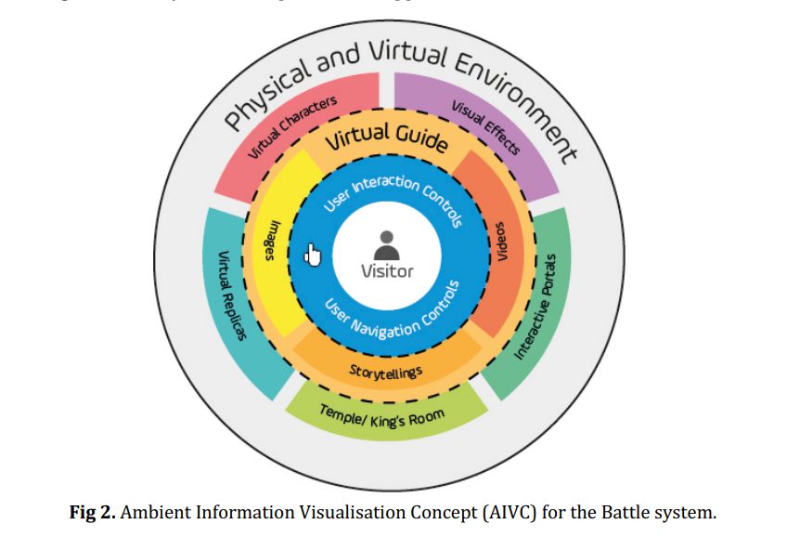

Slide 15
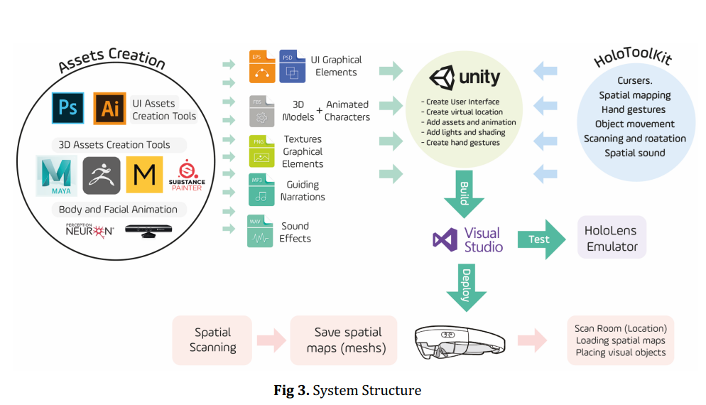

Slide 16
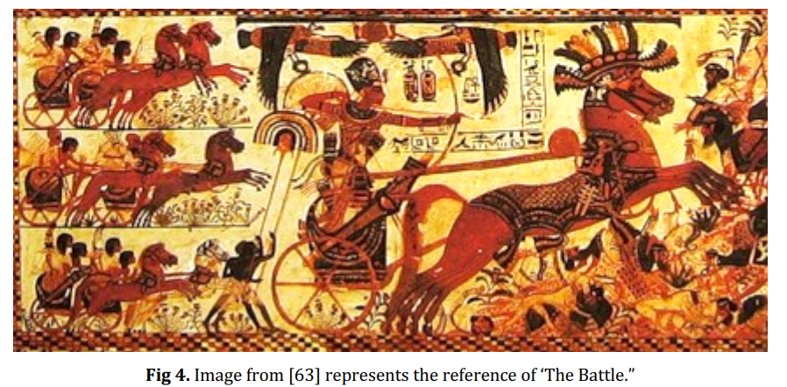

Slide 17
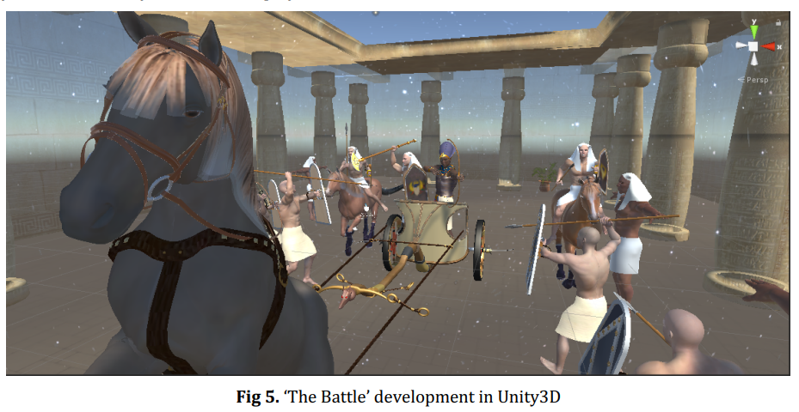

Slide 18
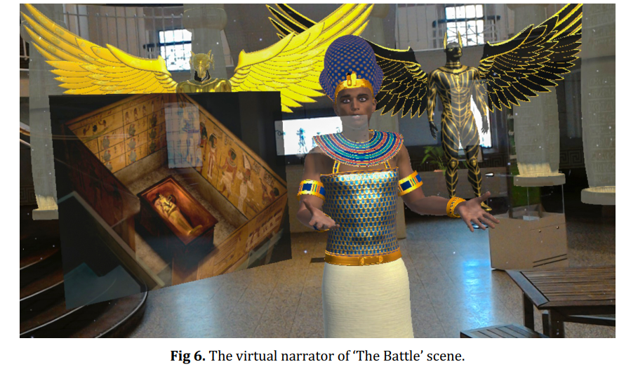

Slide 19
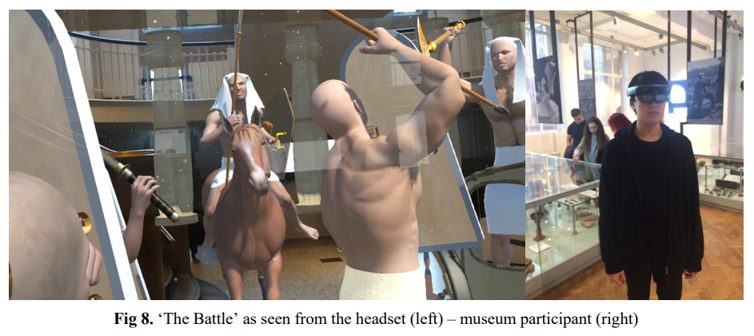

Slide 20
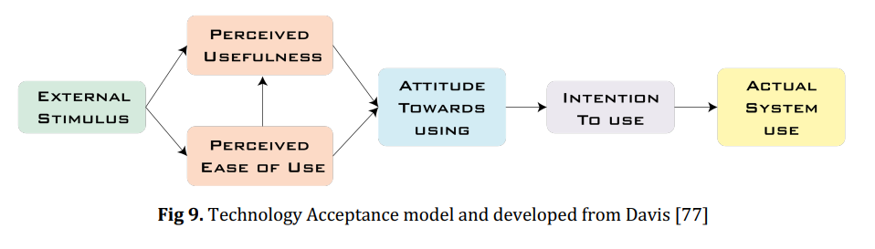

Slide 21
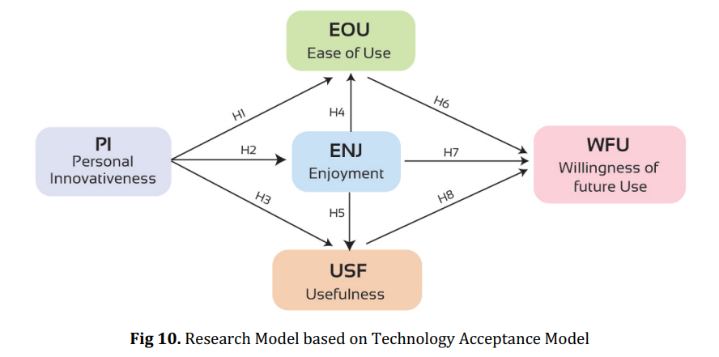

Slide 22
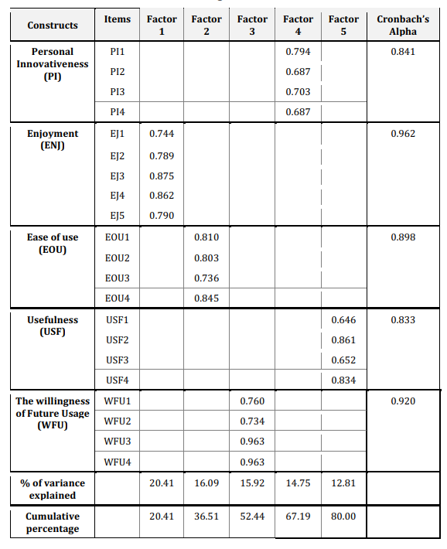

Slide 23
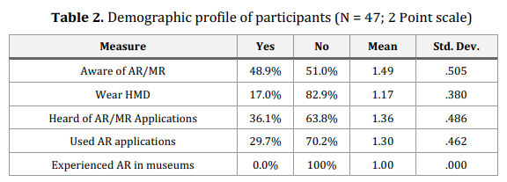

Slide 24
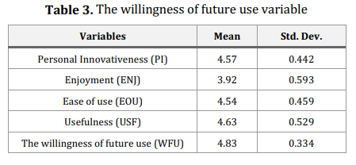

Slide 25
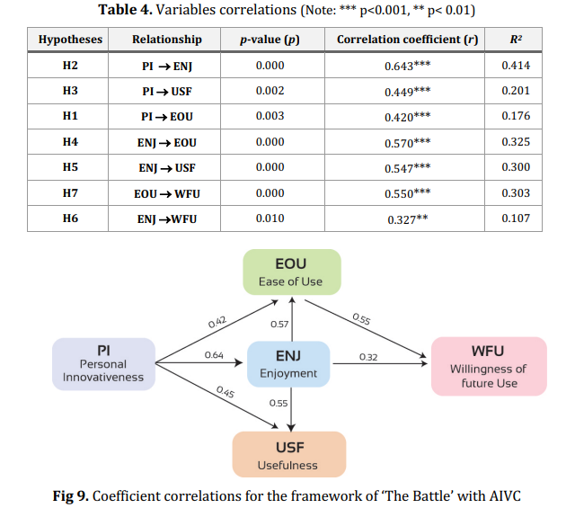

Slide 26
結論

Slide 27
結論
總結來說，個人創新性在使用混合實境和AIVC在博物館環境中所代表的社會規範影響了樂趣、易用性和實用性。應用的實用性和參與者採用系統的意願表明了未來前途看好。

Slide 28
END

